Slide 2
SQL Server: Query Optimization

Slide 3
What is Index
One of the best ways to reduce disk I/O is to use an index
Allows SQL Server to find data in a table without scanning the entire table
Example
SELECT TOP 10 p.ProductID, p.[Name], p.StandardCost, p.[Weight], ROW_NUMBER() OVER (ORDER BY p.Name DESC) AS RowNumber FROM Production.Product p ORDER BY p.Name DESC

Slide 4
Indexes
Indexes are database objects based on table column for faster retrieval of data
Query optimizer depends on indexed columns to function
Separate structure attached to a table
Contain pointers to the physical data
Used to
To quickly find data that satisfy conditions in the WHERE clause.
To find matching rows in the JOIN clause.
To maintain uniqueness of key column during INSERT and UPDATE.
To Sort, Aggregate and Group data.
Notes:
4

Slide 5
Indexes
Index
Clustered Index
Non Clustered Index
Clustered | Non Clustered
Only One Clustered index on a table | More than 1 (Maximum of 999)
Data rows are sorted | Data rows are not sorted
Notes:
5

Slide 6
Types of Index
Clustered Index
–Primary Key Default (but not necessary)
–Data is stored at the leaf level
–Data is ordered by the key
Non-clustered Index
–Uses cluster key or RID of a heap
–INCLUDE stored at leaf
And the rest – outside the scope of this session

Slide 7
Index Tuning
What an index is
The benefits and overhead of an index
General recommendations for index design
Clustered and nonclustered index behavior and comparisons
Recommendations for clustered and nonclustered indexes

Slide 8
Create Index
CREATE UNIQUE CLUSTERED INDEX
ucpk_ind_titles ON
TITLES (Title_id)
WITH PAD_INDEX , FILLFACTOR = 80,
IGNORE_DUP_KEY , SORT_IN_TEMPDB
CREATE NONCLUSTERED INDEX
ncfk_ind_titles ON
TITLES (Pub_id)
WITH PAD_INDEX , FILLFACTOR = 33
Notes:
8

Slide 9
Disadvantages of Index
Additional Disk Space
Insert, Update, Delete Statement become slow

Slide 10
Index Rules
Clustered Index
Choose wisely. Only one per table possible
Primary key by default is clustered. Evaluate default behavior
Non-Clustered Index
More than one possible.
Foreign keys are always good candidate for non-clustered index
(because of joins)
Evaluate ‘Included Columns’ in Indexing. Every NonClustered index contains Clustered Keys
Choose Index Fill Factor wisely.
Find out tables with large row counts but no indexing. Maybe it needs indexes.

Slide 11
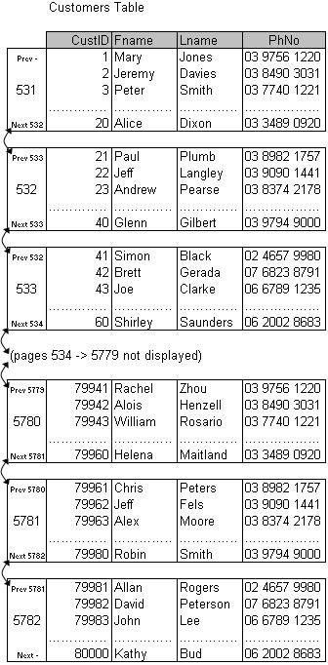

“Heap” Table Storage
No physical ordering of table rows (despite this display)
Scan cannot complete just because a row is located. Because data is not ordered, scan must continue through to end of table (heap)
Table storage structure used when no clustered index on table
Rarely used as CIXs added to PKs by default
Oracle uses Heap storage by default (even with PKs)
No physical ordering of rows
Stored in order of insertion
New pages added to end of “heap” as needed
NO B-Tree index nodes (no “index”)
Query execution example:
Select FName, Lname, PhNo
from Customers where Lname = ‘Smith’
No b-tree with HEAPs, so no lookup method available unless other indexes are present. Only option is to scan heap

Slide 12
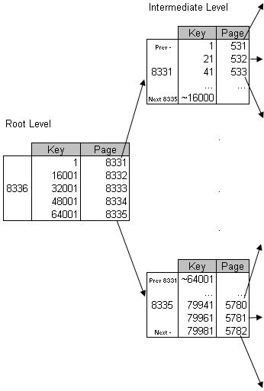

“Clustered Index” Table Storage
Table rows stored in physical order of clustered index key column/s – CustID in this case.
create clustered index cix_CustID on customers (CustID)
CIX also provides b-tree lookup pages, similar to a regular index
Table rows stored in leaf level of clustered index, in physical order of index column/s (key/s)
B-Tree index nodes also created on indexed columns
Each level contains entries based on “cluster key” value from the first row in pages from lower level
Default table storage format for tables WITH a primary key
Query execution example:
Select FName, Lname, PhNo
From Customers where CustID = 23
Can only have one CIX per table (as table storage can only be sorted one way)

Slide 13
Index design recommendations
Examine the WHERE clause and JOIN criteria columns.
Use narrow indexes.
Examine column uniqueness.
Examine the column data type.
Consider column order.
Consider the type of index (clustered versus nonclustered).

Slide 14
How to find missing indexes

Slide 15
Agenda
SQL: set based expression / serial execution
Intro to execution plans
Table & index access methods
Table storage formats – Heaps & Clustered Indexes
Non-clustered Indexes (on Heaps vs on Clustered Indexes)
Covering Indexes
Join operators
Nested Loops Join, Merge Join & Hash Join
Top 10 for Efficient Queries
Efficient usage of Procedures and Views

Slide 16
Why Performance Tuning in SQL Server is necessary
Allowing your system to scale
•Adding more customers
•Adding more features
Improve overall system performance
Save money but not wasting resources
The database is typically one of the most expensive resources in a datacenter

Slide 17
Major Performance Killers
Insufficient indexing
Inaccurate statistics
Improper query design
Poorly generated execution plans
Excessive blocking and deadlocks
Non-set-based operations, usually T-SQL cursors
Inappropriate database design
Excessive fragmentation
Non-reusable execution plans
Frequent recompilation of queries
Improper use of cursors
Improper configuration of the database transaction log
Excessive use or improper configuration of tempdb

Slide 18
Intro to execution plans
Why is understanding Execution Plans important?
Provides insight into query execution steps / processing efficiency
- SQL Server occasionally makes mistakes
Tune performance problems at the source (query efficiency)
More effective than tuning hardware
Other diagnostics only reveal consequences of poor query execution plans
High CPU is only a consequence of poorly tuned query plans
High disk utilization usually just a consequence of poorly tuned query plans
Waitstats reveals high resource utilization of poorly tuned query plans
Locking usually just a consequence of poorly tuned query plans
Tuning query execution plans is a VERY important tuning technique

Slide 19
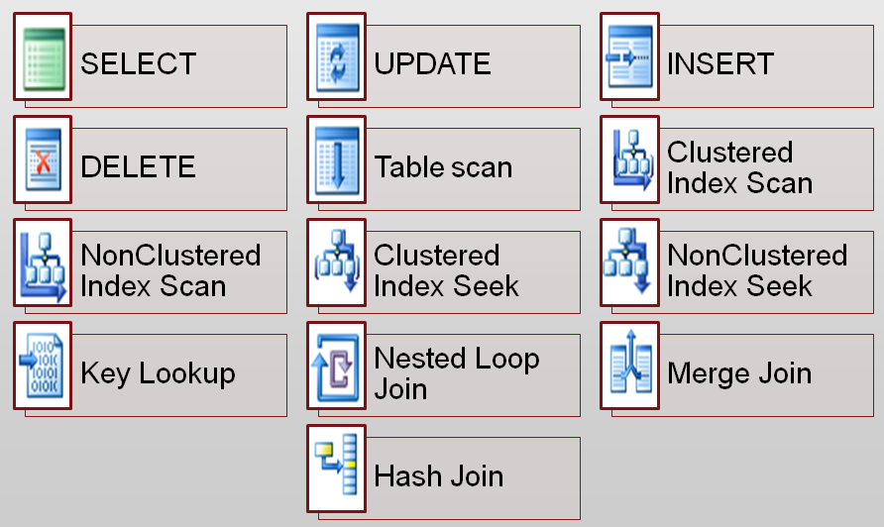
Commonly Used Operators

Slide 20
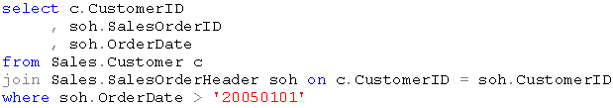
SQL: set based expression / serial execution
SQL syntax based on “set based” expressions (no processing rules)
Returns CustID, OrderID & OrderDate for orders > 1st Jan 2005
No processing rules included in SQL statement, just the “set” of data to be returned
Query execution is serial
SQL Server “compiles” query into a series of sequential steps which are executed one after the other
Individual steps also have internal sequential processing
(eg table scans are processed one page after another & per row within page)
Execution Plans Display these steps

Slide 21
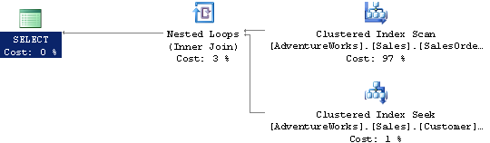
Intro to execution plans – a simple example
Execution Plan shows how SQL Server compiled & executes this query
Ctl-L in SSMS for “estimated” plan (without running query)
Ctl-M displays “actual” plan after query has completed
Table / index access methods displayed (Scan, Seek etc)
Join physical operators displayed (Loops, Merge, Hash)
Plan node cost shown as % of total plan “cost”
Thickness of intra node rows denotes estimated / actual number of rows carried between nodes in the plan
Read Execution Plans from top right to bottom left
In this case, plan starts with Clustered Index Scan of [SalesOrderHeader]
Then, for every row returned, performs an index seek into [Customers]

Slide 22
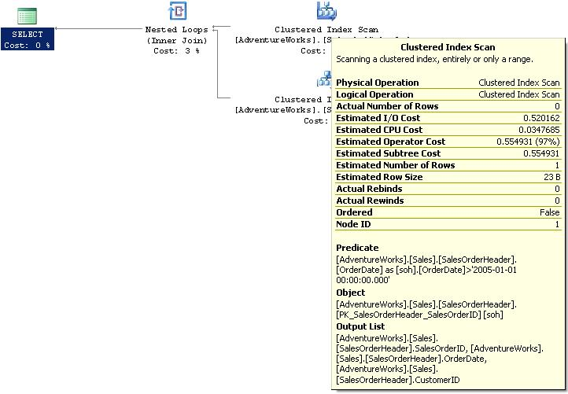
Execution plan node properties
Number of rows returned shown in Actual Execution Plan
Ordered / Unordered – displays whether scan operation follows page “chain” linked list (next / previous page # in page header) or follows Index Allocation Map (IAM) page
Search predicate. WHERE filter in this case, but can also be join filter
Name of Schema object accessed to physically process query – typically an index, but also possibly a heap structure
Mouse over execution plan node reveals extra properties..

Slide 23
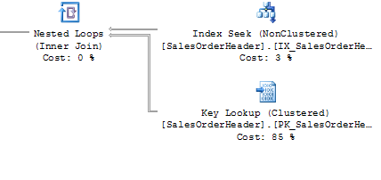
Lookups & Joins
Key
RID

Slide 24
Join Optimization
Hash joins
Merge joins
Nested loop joins

Slide 25



Join Operators (intra-table operators)
Nested Loop Join
Original & only join operator until SQL Server 7.0
“For Each Row…” type operator
Takes output from one plan node & executes another operation “for each” output row from that plan node
Merge Join
Scans both sides of join in parallel
Ideal for large range scans where joined columns are indexed
If joined columns aren’t indexed, requires expensive sort operation prior to Merge
Hash Match
“Hashes” values of join column/s from one side of join
Usually smaller side
“Probes” with the other side
Usually larger side
Hash is conceptually similar to building an index for every execution of a query
Hash buckets not shared between executions
Worst case join operator
Useful for large scale range scans which occur infrequently

Slide 26
Hash Join
A hash join uses the two join inputs as a build input and a probe input.
The build input is shown as the top input in the execution plan, and the probe input is shown as the bottom input.
Usually the smaller of the two inputs serves as the build input because it's going to be stored on the system, so the optimizer attempts to minimize the memory used.
The hash join performs its operation in two phases: the build phase and the probe phase.

Slide 27

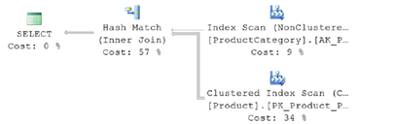
Hash Join – Example
SELECT p.* FROM Production.Product p JOIN Production.ProductCategory pc ON p.ProductSubcategoryID = pc.ProductCategoryID;

Slide 28
Merge Join
A merge join requires both join inputs to be sorted on the merge columns, as defined by the join criterion
Since each join input is sorted, the merge join gets a row from each input and compares them for equality
A matching row is produced if they are equal. This process is repeated until all rows are processed

Slide 29

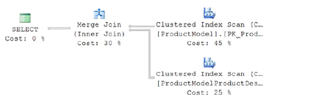
Merge Join - Example

Slide 30
Nested Loop Join
A nested loop join uses one join input as the outer input table and the other as the inner input table
The outer input table is shown as the top input in the execution plan, and the inner input table is shown as the bottom input table
The inner loop, executed for each outer row, searches for matching rows in the inner input table
Nested loop joins are highly effective if the outer input is quite small and the inner input is larger but indexed

Slide 31
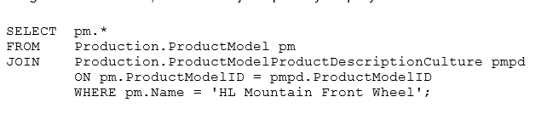
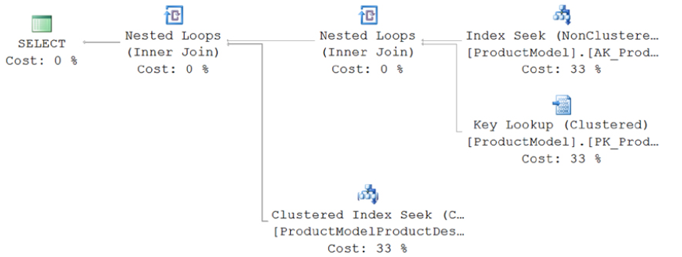
Nested Loop Join - Example

Slide 32
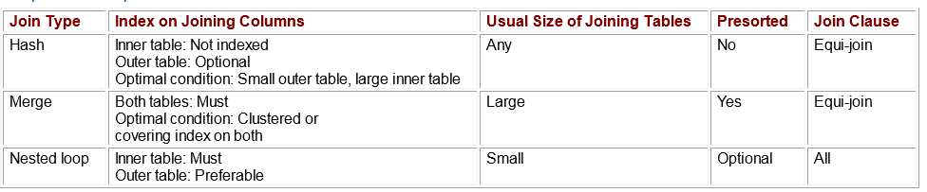
Quick comparison

Slide 33
Force Changing of the Execution Plans
1, Use DBCC
2, run system sp of sp_query_store_force_plan

Slide 34
Top 10 for Building Efficient Queries
1 Favor set-based logic over procedural or cursor logic
• The most important factor to consider when tuning queries is how to properly express logic in a set-based manner.
•Cursors or other procedural constructs limit the query optimizer’s ability to generate flexible query plans.
•Cursors can therefore reduce the possibility of performance improvements in many situations

Slide 35
Top 10 for Building Efficient Queries
2. Test query variations for performance
The query optimizer can often produce widely different plans for logically equivalent queries.
•Test different techniques, such as joins or subqueries, to find out which perform better in various situations.

Slide 36
Top 10 for Building Efficient Queries
3. Avoid query hints.
You must work with the SQL Server query optimizer, rather than against it, to create efficient queries.
Query hints tell the query optimizer how to behave and therefore override the optimizer’s ability to do its job properly.
If you eliminate the optimizer’s choices, you might limit yourself to a query plan that is less than ideal.
Use query hints only when you are absolutely certain that the query optimizer is incorrect.

Slide 37
Top 10 for Building Efficient Queries
4. DO NOT Use correlated subqueries to improve performance.
Since the query optimizer is able to integrate subqueries into the main query flow in a variety of ways, subqueries might help in various query tuning situations.
Subqueries can be especially useful in situations in which you create a join to a table only to verify the existence of correlated rows. For better performance, replace these kinds of joins with correlated subqueries that make use of the EXISTS operator

Slide 38
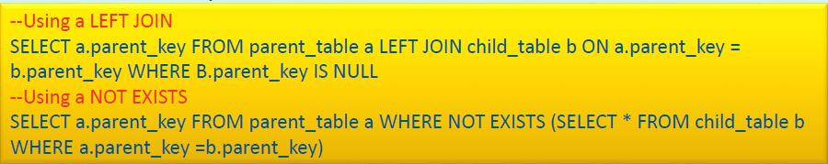
Top 10 for Building Efficient Queries
4. Continued
.

Slide 39
Top 10 for Building Efficient Queries
5. Avoid using a scalar user-defined function in the WHERE clause.
Scalar user-defined functions, unlike scalar subqueries, are not optimized into the main query plan.
Instead, you must call them row-by-row by using a hidden cursor.
This is especially troublesome in the WHERE clause because the function is called for every input row.
Using a scalar function in the SELECT list is much less problematic because the rows have already been filtered in the WHERE clause

Slide 40
Top 10 for Building Efficient Queries
6. Use table-valued user-defined functions as derived tables.
In contrast to scalar user-defined functions, table-valued functions are often helpful from a performance point of view when you use them as derived tables.
The query processor evaluates a derived table only once per query.
If you embed the logic in a table-valued user-defined function, you can encapsulate and reuse it for other queries

Slide 41
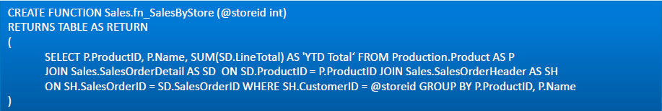
Top 10 for Building Efficient Queries
6. Continued
.

Slide 42
Top 10 for Building Efficient Queries
7 Avoid unnecessary GROUP BY columns
Use a subquery instead.
•The process of grouping rows becomes more expensive as you add more columns to the GROUP BY list.
•If your query has few column aggregations but many non-aggregated grouped columns, you might be able to refactor it by using a correlated scalar subquery.
•This will result in less work for grouping in the query and therefore possibly better overall query performance

Slide 43

Top 10 for Building Efficient Queries
7 Continued
.

Slide 44
Top 10 for Building Efficient Queries
8 .Use CASE expressions to include variable logic in a query
The CASE expression is one of the most powerful logic tools available to T-SQL programmers.
•Using CASE, you can dynamically change column output on a row-by-row basis.
•This enables your query to return only the data that is absolutely necessary and therefore reduces the I/O operations and network overhead that is required to assemble and send large result sets to clients

Slide 45
Top 10 for Building Efficient Queries
9 Divide joins into temporary tables when you query very large tables.
The query optimizer’s main strategy is to find query plans that satisfy queries by using single operations.
•Although this strategy works for most cases, it can fail for larger sets of data because the huge joins require so much I/O overhead.
•In some cases, a better option is to reduce the working set by using temporary tables to materialize key parts of the query. You can then join the temporary tables to produce a final result.

Slide 46
Top 10 for Building Efficient Queries
10. Refactoring Cursors into Queries..
Rebuild logic as multiple queries
•Rebuild logic as a user-defined function
•Rebuild logic as a complex query with a case expression

Slide 47
Stored Procedure
Best Practices
•Avoid using “sp_” as name prefix
•Avoid stored procedures that accept parameters for table names
•Use the SET NOCOUNT ON option in stored procedures
•Limit the use of temporary tables and table variables in stored procedures
•If a stored procedure does multiple data modification operations, make sure to enlist them in a transaction.
•When working with dynamic T-SQL, use sp_executesqlinstead of the EXEC statement

Slide 48
Views
Best Practices
Use views to abstract complex data structures
•Use views to encapsulate aggregate queries
•Use views to provide more user-friendly column names
•Think of reusability when designing views
•Avoid using the ORDER BY clause in views that contain a TOP 100 PERCENT clause.
•Utilize indexes on views that include aggregate data

Slide 49
Recommendations
Explicitly parameterize variable parts of a query.
Use stored procedures to implement business functionality.
Use sp_executesql to avoid stored procedure maintenance.
Use the prepare/execute model to avoid resending a query string.
Avoid ad hoc queries.
Use sp_executesql over EXECUTE for dynamic queries.
Parameterize variable parts of queries with care.
Avoid modifying environment settings between connections.
Avoid the implicit resolution of objects in queries

Slide 50
Transaction Log
A transaction log is a file – integral part of every SQL Server database. It contains log records produced during the logging process in a SQL Server database. The transaction log is the most important component of a SQL Server database when it comes to the disaster recovery – however, it must be uncorrupted.

Slide 51
Thank You

